Slide 1
TEMPLATE Assignment A5a Low-Fidelity Paper Prototype Examples: Project VidStream, CSC318 2020F Table of Contents 5.1 Hierarchical Task Analysis 2 5.2 Usability Testing Script 3 5.3 Low-Fidelity Paper Prototype 4 with Facilitation & Observation notes off-side, outside Slideshow

Slide 2
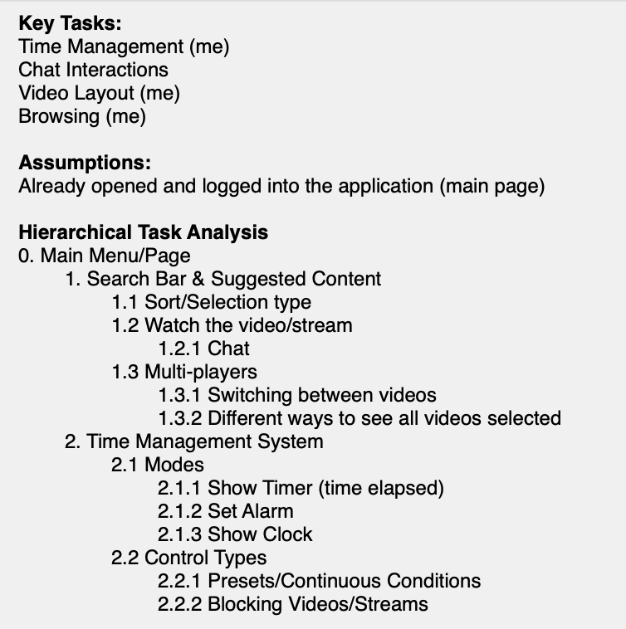
A5.1 Hierarchical Task Analysis

Slide 3
A5.2 Usability Testing Script
Scenario: You are a busy university student. You work hard but need breaks from studying. In these breaks, you struggle to keep track of time and take too long to find the right video to watch. Can you show me how you would do the following tasks using this app:
1. You open the application and want to set a 30 minute alarm so that you can get back to work for at least 90 minutes without distractions.
2. Now that the alarm is set, how can you find a video or stream to watch? Let’s choose the newest video created by your favourite creator about video games.
3. The video is too lengthy but you might want to revisit it later. Find a new video to watch without closing the previous video.
4. You want to view all your videos currently open side-by-side in a window
5. You realize your sleep schedule is important so you would like to block videos/streams from playing past 12:00am until 6:00am.
Please think aloud as you interact with the paper prototype.

Slide 4
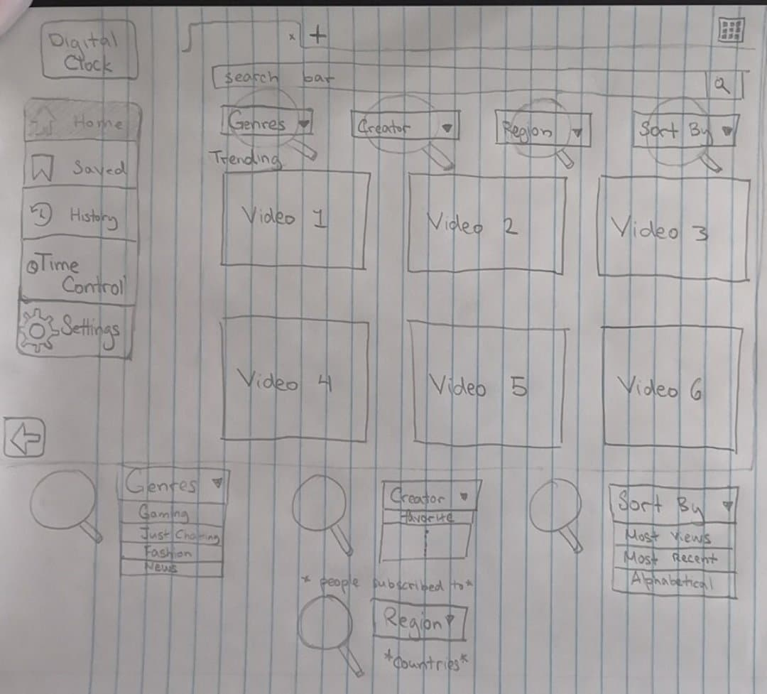
A5.3 Low-Fidelity Paper Prototype
Task 1. You open the application and want to set a 30 minute alarm so that you can get back to work for at least 90 minutes without distractions.
Get to the screen that sets an alarm
Note this column of text does not show during the Usability Test Slide Show; but is used for your note taking & record keeping.
Note the task instructions are repeated here to reduce participant’s memory load.
EXPECTED USER ACTION
Click [MANAGE TASKS]
OBSERVED ACTION
USER QUOTES
DESIGN IMPLICATIONS for A5b Results
View Tabs
Genres pop up
Creator pop up
Sort by pop up
Region pop up

Slide 5
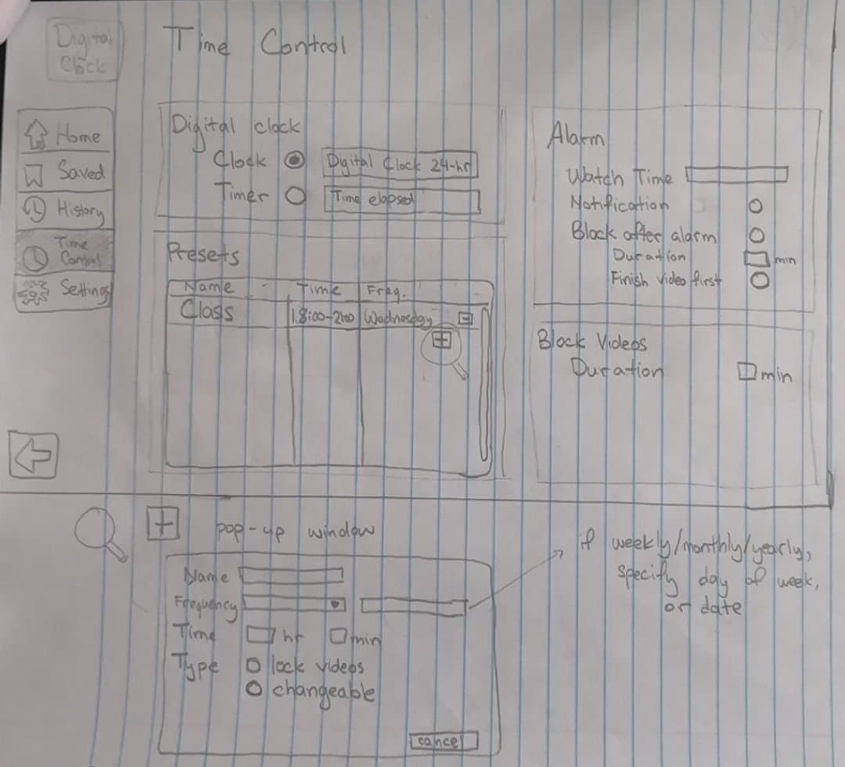

Note this column of text does not show during the Usability Test Slide Show; but is used for your note taking & record keeping.
EXPECTED USER ACTION
Click [October 16]
Click [ADD +]
OBSERVED ACTION
USER QUOTES
DESIGN IMPLICATIONS for A5b Results
Task 1. You open the application and want to set a 30 minute alarm so that you can get back to work for at least 90 minutes without distractions.
Set an alarm that lasts 30 minutes and remove distractions for 90 minutes
Repeated Events
Disable videos
Immediate Video Block
Start Time
Duration
Done Cancel

Slide 6
Note this column of text does not show during the Usability Test Slide Show; but is used for your note taking & record keeping.
EXPECTED USER ACTION
Type FROM [20:00]
Type TO [21:00]
Type LOCATION [Athletic Centre]
Check [EXERCISE]
Check [Weekly]
Check [Alarm (optional)]
Click [CHECK MARK] NOTE it’s good practice to ask users “What do you expect to happen next?”
OBSERVED ACTION
USER QUOTES
DESIGN IMPLICATIONS for A5b Results
[NEXT] button is an Action Button you can program in Powerpoint for navigation.
2. Now that the alarm is set, how can you find a video or stream to watch? Let’s choose the newest video created by your favourite creator about video games.
Return to the main page to search for videos
Alarm
Repeated Events
Disable videos
Immediate Video Block
+ pop up
Start Time
Duration
Done Cancel

Slide 7
2. Now that the alarm is set, how can you find a video or stream to watch? Let’s choose the newest video created by your favourite creator about video games.
Select the type of video you want
Alarm
View Tabs
Genres pop up
Creator pop up
Sort by pop up
Region pop up

Slide 8
2. Now that the alarm is set, how can you find a video or stream to watch? Let’s choose the newest video created by your favourite creator about video games.
Now choose a video to watch
Alarm
View Tabs
Gaming
Favourite
Most Recent
Genres pop up
Creator pop up
Sort by pop up
Region pop up

Slide 9
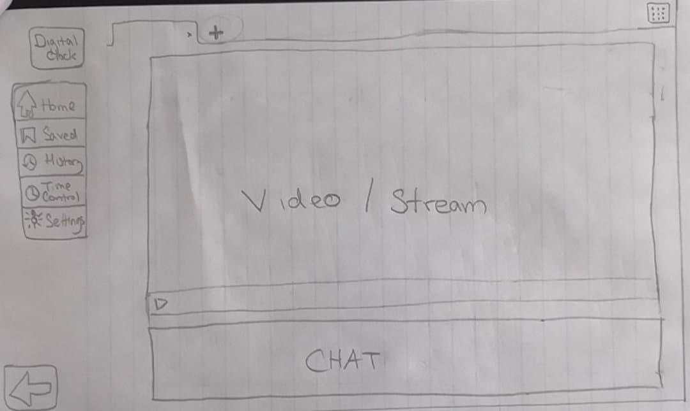
2. Now that the alarm is set, how can you find a video or stream to watch? Let’s choose the newest video created by your favourite creator about video games.
Yey good job :)
Alarm
View Tabs

Slide 10
3. The video is too lengthy but you might want to revisit it later. Find a new video to watch without closing the previous video.
Open a new window to search for another video
Alarm
View Tabs

Slide 11

3. The video is too lengthy but you might want to revisit it later. Find any new video to watch without closing the previous video.
Select a video to watch
Alarm
Video 1
View Tabs
Genres pop up
Creator pop up
Sort by pop up
Region pop up

Slide 12
3. The video is too lengthy but you might want to revisit it later. Find any new video to watch without closing the previous video.
Yey good job :)
Alarm
Video 1
Video 2
View Tabs

Slide 13
4. You want to view all your videos currently open side-by-side in a window
Find the button :o
Alarm
Video 1
Video 2
View Tabs

Slide 14
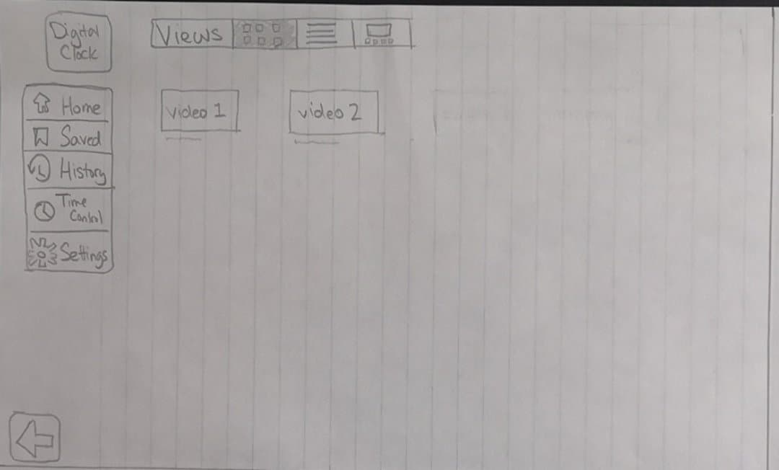
4. You want to view all your videos currently open side-by-side in a window
Yey good job :)
Alarm

Slide 15
5. You realize your sleep schedule is important so you would like to block videos/streams from playing past 12:00am until 6:00am.
Navigate to the window that sets repeated time constraints
Alarm

Slide 16
Note this column of text does not show during the Usability Test Slide Show; but is used for your note taking & record keeping.
EXPECTED USER ACTION
Click [October 16]
Click [ADD +]
OBSERVED ACTION
USER QUOTES
DESIGN IMPLICATIONS for A5b Results
5. You realize your sleep schedule is important so you would like to block videos/streams from playing past 12:00am until 6:00am.
Create a new preset
Alarm
Repeated Events
Disable videos
Immediate Video Block
+ pop up

Slide 17
Note this column of text does not show during the Usability Test Slide Show; but is used for your note taking & record keeping.
EXPECTED USER ACTION
Click [October 16]
Click [ADD +]
OBSERVED ACTION
USER QUOTES
DESIGN IMPLICATIONS for A5b Results
5. You realize your sleep schedule is important so you would like to block videos/streams from playing past 12:00am until 6:00am.
Input the correct settings!
Alarm
Repeated Events
Disable videos
Immediate Video Block
Start Time
Duration
Done Cancel

Slide 18
Note this column of text does not show during the Usability Test Slide Show; but is used for your note taking & record keeping.
EXPECTED USER ACTION
Click [October 16]
Click [ADD +]
OBSERVED ACTION
USER QUOTES
DESIGN IMPLICATIONS for A5b Results
5. You realize your sleep schedule is important so you would like to block videos/streams from playing past 12:00am until 6:00am.
Input the correct settings!
Alarm
Repeated Events
Disable videos
Immediate Video Block
Sleep
Daily
Start Time
12
00
Duration
6
00
Done Cancel

